Slide 1


Subject Name : EC8652-WIRELESS COMMUNICATION Presentation Title: CDMA Types and its Applications
JEPPIAAR INSTITUTE OF TECHNOLOGY
“Self-Belief | Self Discipline | Self Respect”
Department of Electronics and Communication Engineering
Team Members:
Students Name Reg.No:
1. Pravin A 210617106060
2. Giri Prasath P 210617106032
3. Ramakrishnan S 210617106068
4. Ajith J 210617106003
5. Kalaiselvi G 210617106044
6. Mahalakshmi T 210617106052

Slide 2
Objective
To know about the CDMA, it's functions structure and it's uses.
To know a application of the CDMA in the Wireless communication.

Slide 3
CDMA (Code-Division Multiple Access)
CDMA (Code-Division Multiple Access) refers to any of several protocols used in second-generation (2G) and third-generation (3G) wireless communications. As the term implies, CDMA is a form of multiplexing, which allows numerous signals to occupy a single transmission channel, optimizing the use of available bandwidth
The technology is used in ultra-high-frequency (UHF) cellular telephone systems in the 800-MHz and 1.9-GHz bands.

Slide 4
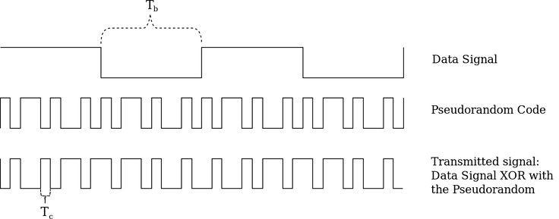
Block Diagram

Slide 5
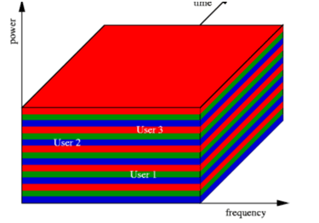
Detailed figure about CDMA

Slide 6
Types of CDMA
1. Direct Sequence Spread Spectrum-CDMA
In a Direct Sequence Spread Spectrum (DSSS) transmitter, the information signal i (t) is directly modulated by a spreading sequence.
The spreading sequence consists of a number of spreading chips with time duration.
The information signal consists of a number of information bits with time duration.
Spreading is achieved if multiple chips represent one bit as code created then is encrypted to high standards.

Slide 7
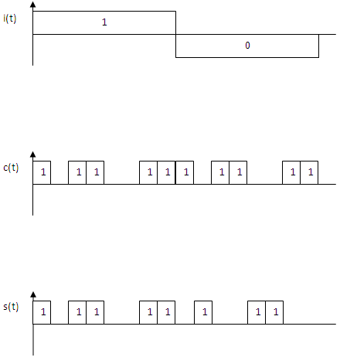
Generation of DSSS signal
DSSS signals,s(t) can be generated by multiplying information signal, i(t) and spreading sequence, c(t). Figure below shows the generation of a DSSS signal:

Slide 8
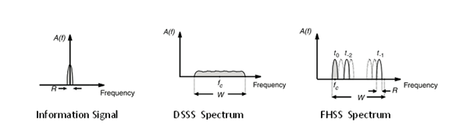
Types of CDMA
2. Frequency Hopping Spread Spectrum-CDMA
Frequency Hopping Spread Spectrum (FHSS) systems change the carrier frequency of the modulated information signal periodically.
The available frequency spectrum is divided into N frequency slices and the set of available frequencies is called a hop–set.
The carrier frequency changes (to one of the frequencies in a hop-set) after regular time interval.

Slide 9
Types of CDMA
3. Time Hopping Spread Spectrum-CDMA
In Time Hopping Spread Spectrum (THSS) system, the time axis is divided into frames of the duration.
A single user uses one slot out of k possible slots within one frame and sends data with k times higher data rate in contrast to the situation where the data is transmitted within the whole frame.

Slide 10
Types of CDMA
High Degree of Synchronization between the sender and the receiver
In CDMA, use of orthogonal codes is widely present. When these codes are applied, even a slight mismatching between the transmitter and the receiver can decode the whole message in a wrong way and produce lots of errors.

Slide 11
Future Scope
CDMA is openly regarded as the highway mode of wireless communications and has been responsible for giving fast and safe modes of data exchange such as 3G and recently it has been merged with GSM to give high speed 4G or LTE internet services.
Highly digital, CDMA stands as a power efficient and hence an economic data exchange mode which can connect almost every part of the world without posing risk to the data in terms of secrecy and losses.

